Slide 1
Regression
.
. Discovering Knowledge in Data: Data Mining Methods and Models, By Daniel T. Larose. Copyright 2005 John Wiley & Sons, Inc

Slide 2
An Example of Simple Linear Regression
Cereals data set contains nutritional information for 77 cereals
Includes sugars and rating variables
Suppose we estimate rating of a cereal, given its sugar content?
Use sugars (predictor) to estimate rating (response)
Cereal Name | Manuf | Sugars | Calories | Protein | Fat | Sodium | Rating
100% Bran | N | 6 | 70 | 4 | 1 | 130 | 68.4030
100% Natural Bran | Q | 8 | 120 | 3 | 5 | 15 | 33.9837
All-Bran | K | 5 | 70 | 4 | 1 | 260 | 59.4255
All-Bran Extra Fiber | K | 0 | 50 | 4 | 0 | 140 | 93.7049
Almond Delight | R | 8 | 110 | 2 | 2 | 200 | 34.3848
Discovering Knowledge in Data: Data Mining Methods and Models, By Daniel T. Larose. Copyright 2005 John Wiley & Sons, Inc.

Slide 3
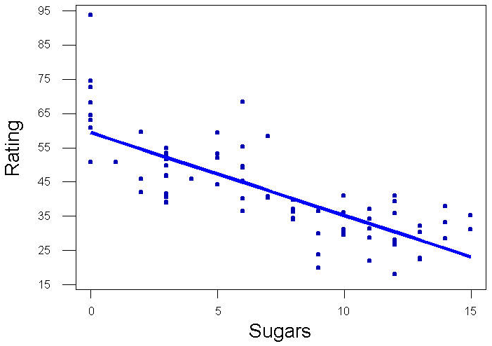

An Example of Simple Linear Regression (cont’d)
Scatter plot of rating vs. sugars and least squares regression line
Regression Line or Estimated Regression Equation (ERE):
Estimated Rating
Actual Rating (for Cheerios)
Discovering Knowledge in Data: Data Mining Methods and Models, By Daniel T. Larose. Copyright 2005 John Wiley & Sons, Inc.

Slide 4
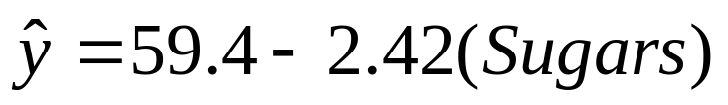
ŷ Estimated value of response variable
b₀ y-intercept of regression line
b₁ slope of regression line
Together, b₀ and b₁ are regression coefficients
ERE for Cereals data set:
ERE interpreted as: “Estimated cereal rating equals 59.4 minus 2.42 times the sugar content in grams”
ERE used to make estimates or predictions
Discovering Knowledge in Data: Data Mining Methods and Models, By Daniel T. Larose. Copyright 2005 John Wiley & Sons, Inc.

Slide 5

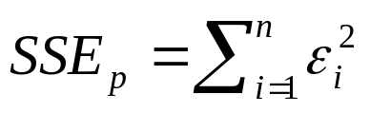
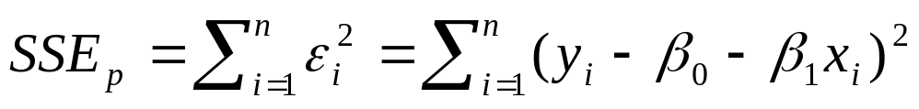
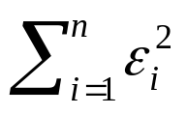
Suppose we have n observations from model
Least squares line minimizes population sum of squares
Population sum of squared errors re-expressed
Differential calculus determines values for β₀ and β₁ which minimize
Discovering Knowledge in Data: Data Mining Methods and Models, By Daniel T. Larose. Copyright 2005 John Wiley & Sons, Inc.

Slide 6
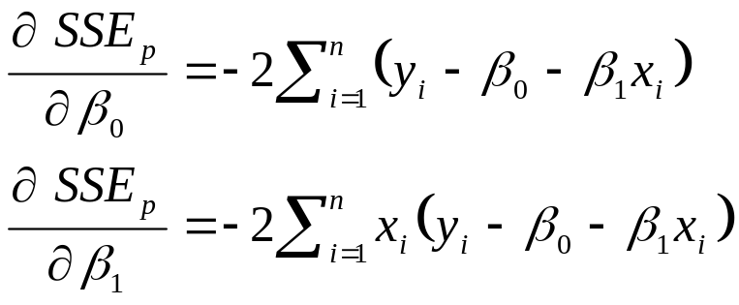
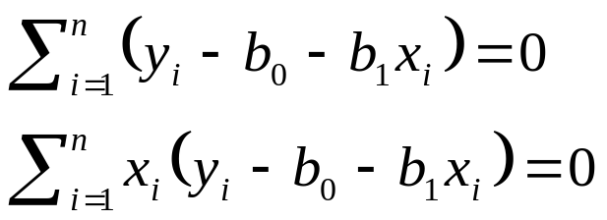
Partial derivatives with respect to β₀ and β₁ are derived
Setting equations equal to zero, values for estimates b₀ and b₁ are determined
Discovering Knowledge in Data: Data Mining Methods and Models, By Daniel T. Larose. Copyright 2005 John Wiley & Sons, Inc.

Slide 7
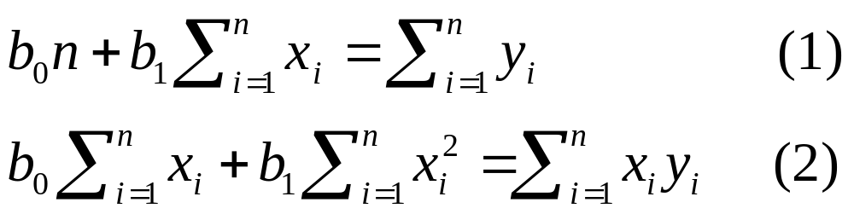
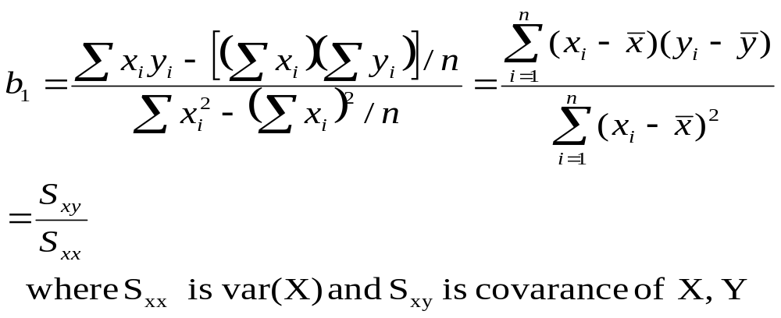
Rearrange the equations
Next, summation distributed then equations re-expressed
(2)*n –(1)* ∑x, we can find b₁
Discovering Knowledge in Data: Data Mining Methods and Models, By Daniel T. Larose. Copyright 2005 John Wiley & Sons, Inc.

Slide 8
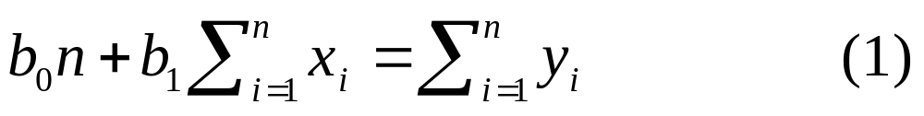
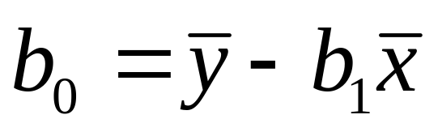
Discovering Knowledge in Data: Data Mining Methods and Models, By Daniel T. Larose. Copyright 2005 John Wiley & Sons, Inc.

Slide 9
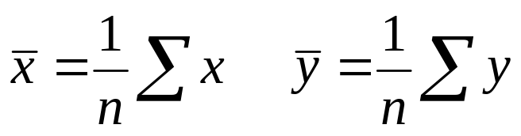
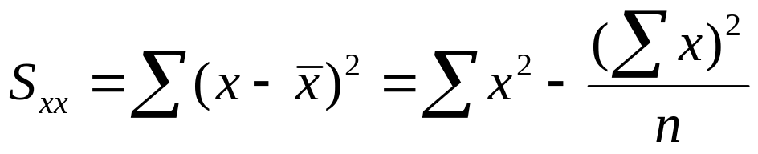
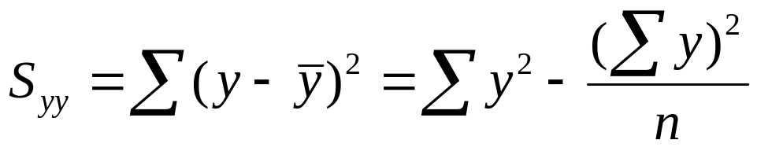
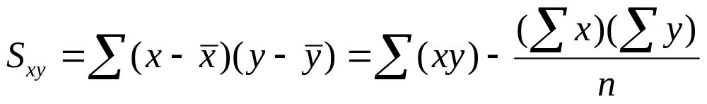
Basic Notations
Discovering Knowledge in Data: Data Mining Methods and Models, By Daniel T. Larose. Copyright 2005 John Wiley & Sons, Inc.

Slide 10
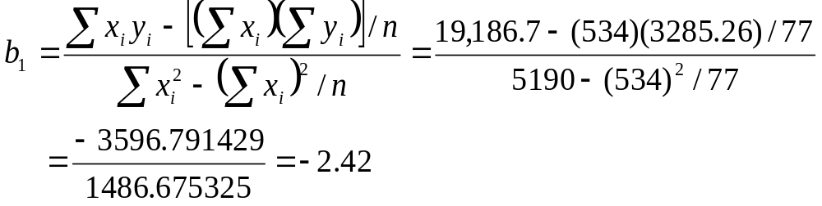
Formulas produce b₀ and b₁ , least squares estimates for β₀ and β₁ , respectively
Applying formulas to 77 observations in Cereals data set produces estimates b₀ = 59.4 and b₁ = -2.42
Discovering Knowledge in Data: Data Mining Methods and Models, By Daniel T. Larose. Copyright 2005 John Wiley & Sons, Inc.
Notes:
期末考會考mean 以及上面的計算

Slide 11
The y-intercept is the location where ERE intercepts the y-axis
That is, the value for response when the predictor equals zero
Here, ERE estimates a cereal with zero grams of sugar to have 59.4 rating points
However, many modeling situations lack interpretive meaning for the y-intercept when the predictor value is zero
Consider predicting a person’s weight based on height.
Height = 0 unclear
In this case, the y-intercept cannot be interpreted
Discovering Knowledge in Data: Data Mining Methods and Models, By Daniel T. Larose. Copyright 2005 John Wiley & Sons, Inc.

Slide 12
Slope of ERE measures change in y per unit increase of x
b₁ = -2.42 interpreted as: “For each increase in one gram in sugar content, the estimated nutritional rating decreases by 2.42 rating points”
Discovering Knowledge in Data: Data Mining Methods and Models, By Daniel T. Larose. Copyright 2005 John Wiley & Sons, Inc.

Slide 13
R² --Strength of A Linear Relation
Least Squares Regression Method can approximate linear relationship between any two variables
How useful is fitted regressed line?
Useful for making predictions?
R² statistic is Coefficient of Determination and measures ERE’s goodness of fit to data
Discovering Knowledge in Data: Data Mining Methods and Models, By Daniel T. Larose. Copyright 2005 John Wiley & Sons, Inc.
Notes:
R 平方如果太小那就不是一個好的方程式

Slide 14
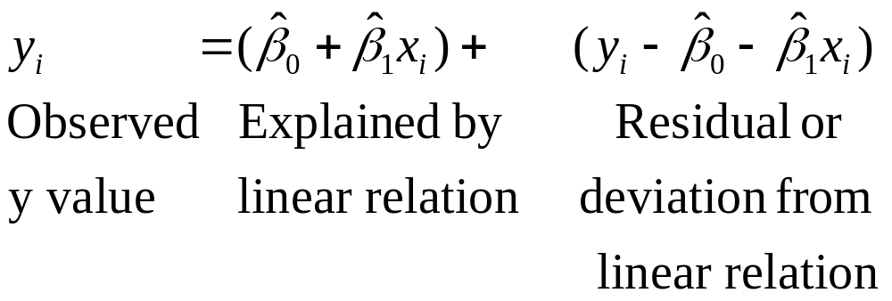
Want to know how much of the variation in the response variable is explained by the fitted regression line
Ideally, the residuals are all zero, and the y values are completely accounted for or explained by the linear dependence on x.
Discovering Knowledge in Data: Data Mining Methods and Models, By Daniel T. Larose. Copyright 2005 John Wiley & Sons, Inc.

Slide 15
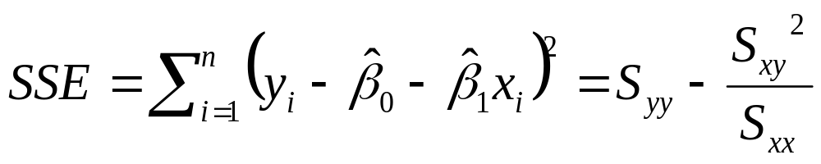
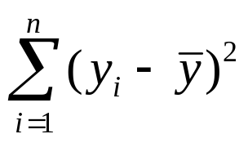
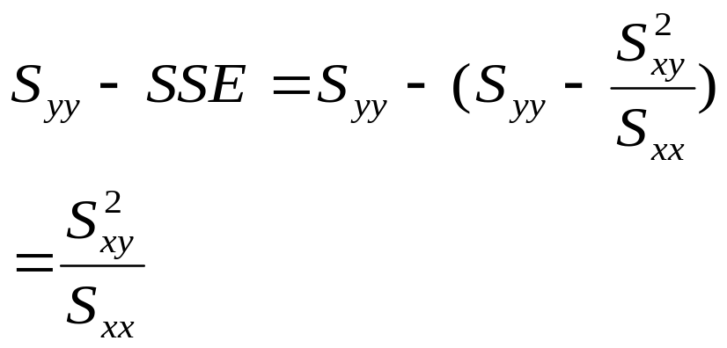
Sum of Squares of the residuals (or errors)
Sum of squares of total: SST = S_{yy} =
Sum of squares regression SSR=
Discovering Knowledge in Data: Data Mining Methods and Models, By Daniel T. Larose. Copyright 2005 John Wiley & Sons, Inc.

Slide 16
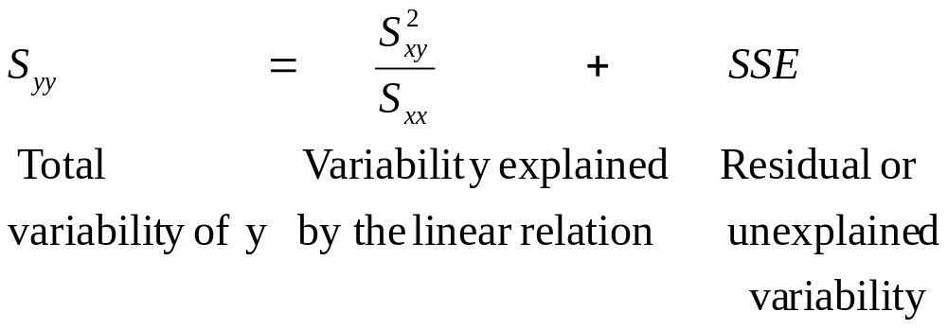
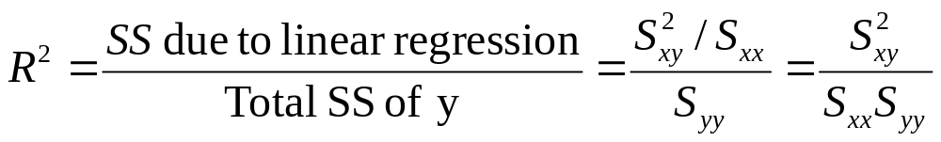
Decomposition of Variability
Discovering Knowledge in Data: Data Mining Methods and Models, By Daniel T. Larose. Copyright 2005 John Wiley & Sons, Inc.

Slide 17


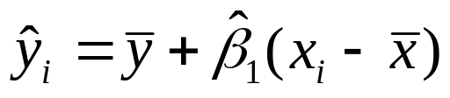
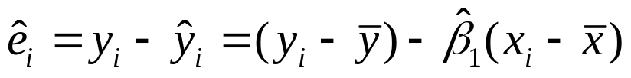
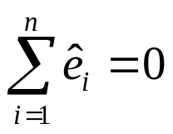
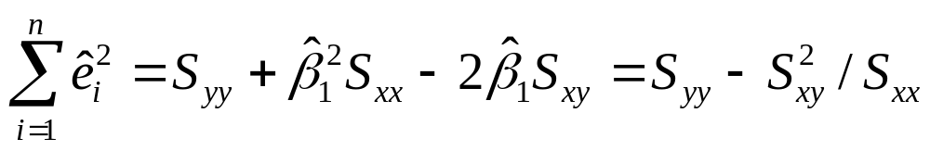
An important exercise
To see why the residuals always sum to zero, refer to the foumulas of and and verify that
(a) the predicted values are
(b) the residuals are
Then show that
(c) verify that
Discovering Knowledge in Data: Data Mining Methods and Models, By Daniel T. Larose. Copyright 2005 John Wiley & Sons, Inc.

Slide 18
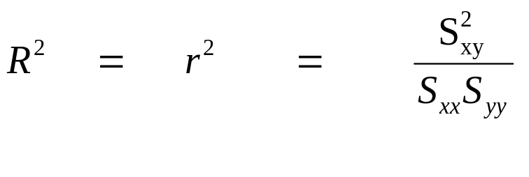
The strength of a linear relation is measured by
Where r is the sample correlation coefficient whose value is
between -1 and 1. r² is always between 0 and 1.
Discovering Knowledge in Data: Data Mining Methods and Models, By Daniel T. Larose. Copyright 2005 John Wiley & Sons, Inc.

Slide 19




Consider Orienteering data set size = 10
Measures elapsed time and distance traveled by hikers
Orienteering data set with ERE ŷ = 6 + 2x
Residual (y - ŷ) and residual squared (y - ŷ)² shown
Subject | X = Time | Y = Distance | Predicted Score | Error in Prediction | (Error in Prediction)²
1 | 2 | 10 | 10 | 0 | 0
2 | 2 | 11 | 10 | 1 | 1
3 | 3 | 12 | 12 | 0 | 0
4 | 4 | 13 | 14 | -1 | 1
5 | 4 | 14 | 14 | 0 | 0
6 | 5 | 15 | 16 | -1 | 1
7 | 6 | 20 | 18 | 2 | 4
8 | 7 | 18 | 20 | -2 | 4
9 | 8 | 22 | 22 | 0 | 0
10 | 9 | 25 | 24 | 1 | 1
= 12
Discovering Knowledge in Data: Data Mining Methods and Models, By Daniel T. Larose. Copyright 2005 John Wiley & Sons, Inc.
Notes:
10個sample很適合當exam 要去練習一下喔~

Slide 20
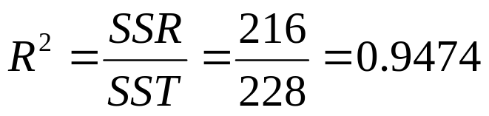
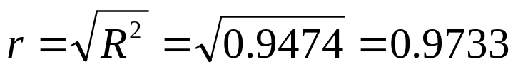
Recall SST = 228 and SSE = 12 for Orienteering data set
Now, SSR = SST-SSE=228 – 12 = 216
Coefficient of Determination:
R² is proportion of variability in response variable explained by ERE
Maximum value for R² occurs when all data points lie exactly (perfect fit) on ERE
Here, because SSE = 0, R² = SSR/SST = 1
Discovering Knowledge in Data: Data Mining Methods and Models, By Daniel T. Larose. Copyright 2005 John Wiley & Sons, Inc.

Slide 21
Interpreting R² analogous to feeling when receiving grade on exam:
  Extremely pleased with score above 90%
  Happy with score above 80%
  Somewhat satisfied with score above 70%
  Very disappointed with score below 50%
Heuristic general guideline only and requires judgment
Discovering Knowledge in Data: Data Mining Methods and Models, By Daniel T. Larose. Copyright 2005 John Wiley & Sons, Inc.

Slide 22

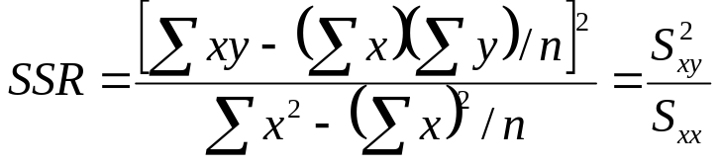
Computation formulas used to calculate SST and SSR
Discovering Knowledge in Data: Data Mining Methods and Models, By Daniel T. Larose. Copyright 2005 John Wiley & Sons, Inc.

Slide 23
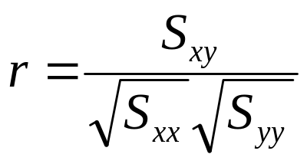
The Correlation Coefficient
Sample Correlation Coefficient measures strength of linear relationship between two quantitative variables
Where -1.0 ≤ r ≤ 1.0, and s_{x} and s_{y} are sample standard deviations for x and y, respectively
r close to 1: Variables are positively correlated, and as x increases, y increases
r close to -1: Variables are negatively correlated, and as x increases, y decreases
Other values for r imply variables are uncorrelated
Discovering Knowledge in Data: Data Mining Methods and Models, By Daniel T. Larose. Copyright 2005 John Wiley & Sons, Inc.

Slide 24
The Correlation Coefficient (cont’d)
Correlation strong, mild, or weak between two variables?
Rough guidelines for interpreting correlation between two variables:
  r > 0.7 positively correlated
  0.33 < r ≤ 0.7 mildly positively correlated
  -0.33 < r ≤ 0.33 not correlated
  -0.7 < r ≤ -0.33 mildly negatively correlated
  r ≤ -0.7 negatively correlated
Depending on field of study, presence/absence of correlation requires determination by more rigorous tests!
Discovering Knowledge in Data: Data Mining Methods and Models, By Daniel T. Larose. Copyright 2005 John Wiley & Sons, Inc.

Slide 25
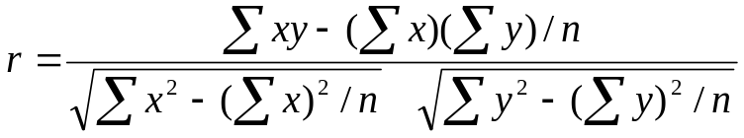
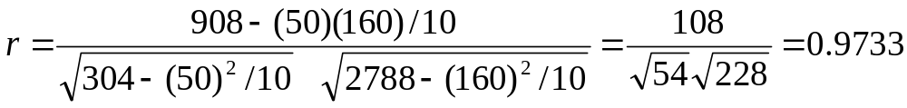


The Correlation Coefficient (cont’d)
Computation formula for r
r calculated using Orienteering data set indicates time and distance hiking are strongly positively correlated
r conveniently expressed as
  r is positive when b₁ is positive
  r is negative when b₁ is negative
From Orienteering example,
Discovering Knowledge in Data: Data Mining Methods and Models, By Daniel T. Larose. Copyright 2005 John Wiley & Sons, Inc.

Slide 26
ANOVA Table for Simple Linear Regression
Regression statistics summarized in Analysis of Variance (ANOVA) table
m = total predictors, n = total observations
F statistic used for inferential purposes
Source of Variation | Sum of Squares | df | Mean Square | F
Regression | SSR | m | MSR=SSR/m
Error(or residual) | SSE | n-m-1 | MSE=SSE/(n-m-1) | F=MSR/MSE
Total | SST=SSR+SSE | n-1
Discovering Knowledge in Data: Data Mining Methods and Models, By Daniel T. Larose. Copyright 2005 John Wiley & Sons, Inc.

Slide 27

The Regression Model
Least Squares Regression elegant and powerful
For model building and inference purposes, regression model assumptions require validation
Deploying model with unverified assumptions can result in failure!
Regression Model:
  β₀ and β₁ model parameters are y-intercept and slope, respectively. True values unknown, estimated by ERE.
  ε error term required because linear approximation to actual predictor-response relationship not deterministic. ε is a random variable.
Discovering Knowledge in Data: Data Mining Methods and Models, By Daniel T. Larose. Copyright 2005 John Wiley & Sons, Inc.

Slide 28
Four Assumptions on Error Term ε :
(1) Zero Mean Assumption
  Error term ε random variable with mean, E(ε) = 0
(2) Constant Variance Assumption
  Variance of ε constant, regardless of x-value
(3) Independence Assumption
  Values of ε independent of x
(4) Normality Assumption
  Error term ε normally distributed random variable
Summary: ε_{i} are independent normal random variables, with mean = 0 and constant variance
Discovering Knowledge in Data: Data Mining Methods and Models, By Daniel T. Larose. Copyright 2005 John Wiley & Sons, Inc.

Slide 29
Implied Behavior of Response Variable y:
(1) Based on: Zero Mean Assumption
  For each x, mean of y’s lie on regression line
(2) Based on: Constant Variance Assumption
  Regardless of x-value, variance of y’s constant
(3) Based on: Independence Assumption
  For any x, values of y independent
(4) Based on: Normality Assumption
  y normally distributed random variable
Discovering Knowledge in Data: Data Mining Methods and Models, By Daniel T. Larose. Copyright 2005 John Wiley & Sons, Inc.

Slide 30
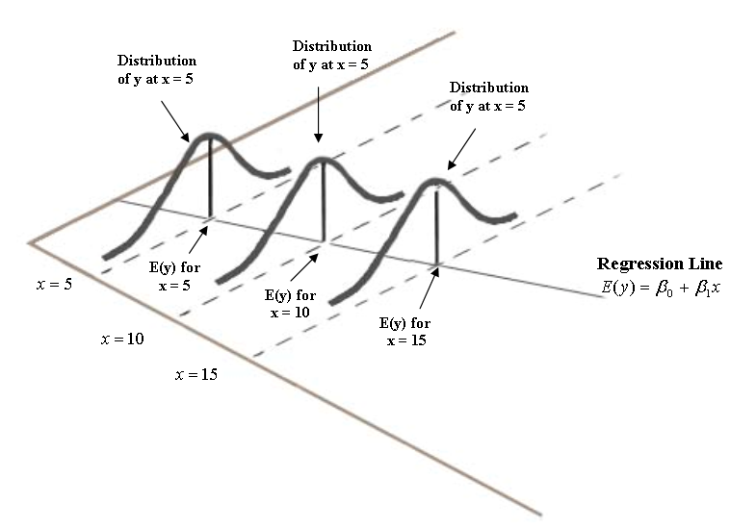
Normality of y_{i}, with mean β₀ + β₁x and constant variance σ² shown
Observed y-values corresponding to predictor values x = 5, 10, and 15 are samples from normal distribution with mean β₀ + β₁x
Normal curves have
exactly same shape
Discovering Knowledge in Data: Data Mining Methods and Models, By Daniel T. Larose. Copyright 2005 John Wiley & Sons, Inc.

Slide 31
Regression analysis can be applied in descriptive manner
Here, validating regression assumptions not important where inference or model building not performed
However, regression assumptions must be validated where inference or model building performed
Discovering Knowledge in Data: Data Mining Methods and Models, By Daniel T. Larose. Copyright 2005 John Wiley & Sons, Inc.

Slide 32
Suppose data set unfamiliar with x and y values in range -4 to 4
Predicting y with x, ERE determines r² = 0.3%
r² value indicates linear relationship not useful
Are we sure?
Can relationship between x and y exist when r² is small?
Inference offers systematic framework to assess significance of linear association between x and y
Next, four inferential methods explored
Discovering Knowledge in Data: Data Mining Methods and Models, By Daniel T. Larose. Copyright 2005 John Wiley & Sons, Inc.

Slide 33
Inference in Regression (cont’d)
Four inferential methods:
(1) T-test for relationship between response and predictor
(2) Confidence interval for slope, β₁
(3) Confidence interval for mean of response, given an x-value
(4) Prediction interval for random response value, given an x-value
Regression equation asserts linear relationship between x and y
Discovering Knowledge in Data: Data Mining Methods and Models, By Daniel T. Larose. Copyright 2005 John Wiley & Sons, Inc.

Slide 34
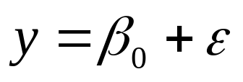
Inference in Regression (cont’d)
β₁ model parameter, whose true value unknown
What value of β₁ indicates linear relationship between x and y non-existent?
When β₁ = 0, regression equation becomes:
Now, linear relationship no longer exists
However, linear relationship does exist where β₁ ≠ 0
Inference based on this key idea
Discovering Knowledge in Data: Data Mining Methods and Models, By Daniel T. Larose. Copyright 2005 John Wiley & Sons, Inc.

Slide 35
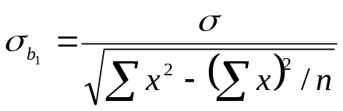
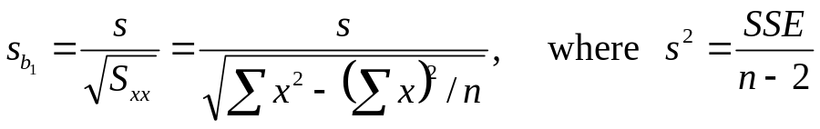
T-test for Relationship Between x and y
Least squares estimate of slope b_{1,} is a statistic
Sampling distribution of b₁ has mean = β₁ , and standard error σ_{b1}:
That is, regression inference about β₁ based on sampling distribution of b₁
s_{b1} is the point estimate of σ_{b1,} where s = standard error of the estimate:
Discovering Knowledge in Data: Data Mining Methods and Models, By Daniel T. Larose. Copyright 2005 John Wiley & Sons, Inc.

Slide 36
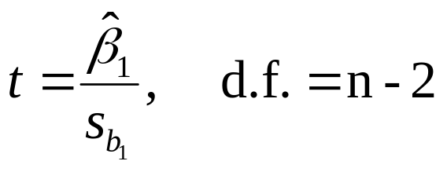
T-test for Relationship Between x and y (cont’d)
S_{b1} interpreted to measure variability of slope
Large values S_{b1} indicate estimate of slope b₁ unstable
Small values S_{b1} indicate estimate of slope b₁ precise
T-test based on t-distribution with n-2 degrees of freedom:
Discovering Knowledge in Data: Data Mining Methods and Models, By Daniel T. Larose. Copyright 2005 John Wiley & Sons, Inc.

Slide 37
T-test for Relationship Between x and y (cont’d)
Example: applying t-test to regression results of nutritional rating on sugar content
Minitab results shown:
    The regression equation is
    Rating = 59.4 - 2.42 Sugars
    Predictor Coef SE Coef T P
    Constant 59.444 1.951 30.47 0.000
    Sugars -2.4193 0.2376 -10.18 0.000
    S = 9.16160 R-Sq = 58.0% R-Sq(adj) = 57.5%
    Analysis of Variance
    Source DF SS MS F P
    Regression 1 8701.7 8701.7 103.67 0.000
    Residual Error 75 6295.1 83.9
    Total 76 14996.8
Discovering Knowledge in Data: Data Mining Methods and Models, By Daniel T. Larose. Copyright 2005 John Wiley & Sons, Inc.

Slide 38
T-test for Relationship Between x and y (cont’d)
b₁ = -2.4193 found under “Coef”
S_{b1} = 0.2376 found under “SE Coef”
T-statistic value, t = b₁ / S_{b1} = -2.4193/0.2376 = -10.18 found under “T”
P-value for t-statistic found under “P” represented by:
Where t_{obs} observed value of t-statistic from regression
Actual p-value less than 0.000
Discovering Knowledge in Data: Data Mining Methods and Models, By Daniel T. Larose. Copyright 2005 John Wiley & Sons, Inc.

Slide 39
T-test for Relationship Between x and y (cont’d)
Null hypothesis, Ho: asserts β₁ = 0 (no linear relationship exists)
Alternative hypothesis, H1: asserts β₁ ≠ 0 (linear relationship exists)
Therefore, t-test rejects Ho when p-value small
Routinely, 0.05 used as rejection threshold
Because p-value ~ 0.000 in example, Ho rejected indicating linear relationship exists between nutritional rating and sugar content
Discovering Knowledge in Data: Data Mining Methods and Models, By Daniel T. Larose. Copyright 2005 John Wiley & Sons, Inc.

Slide 40
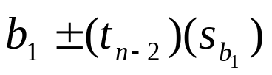
Confidence Interval for Slope of Regression Line
Researchers may prefer to estimate slope of regression line β₁, using confidence interval
Interval is t-interval, based on sampling
distribution for b₁
100(1-alpha)% confidence interval for slope β₁, where t_{n-2} based on n-2 degrees of freedom:
We are 100(1-alpha)% confident true slope β₁ lies within interval
Discovering Knowledge in Data: Data Mining Methods and Models, By Daniel T. Larose. Copyright 2005 John Wiley & Sons, Inc.

Slide 41
Confidence Interval for Slope of Regression Line (cont’d)
Example: construct 95% confidence interval for true slope β₁
Again, using regression results of nutritional rating on sugar content
Recall b₁ = –2.4193, S_{b1} = 0.2376
T-critical value for 95% confidence and n – 2 = 75 degrees of freedom = t_{75,0.025}= 2.0
Therefore, confidence interval equals –2.4193 ± (2.0) (0.2376) = (–2.8945, –1.9441)
Discovering Knowledge in Data: Data Mining Methods and Models, By Daniel T. Larose. Copyright 2005 John Wiley & Sons, Inc.

Slide 42
We are 95% confident true slope of regression line lies between –2.8945 and –1.9441
For each additional gram of sugar, nutritional rating decreases between 1.94 and 2.89 points
Note point β₁ = 0 not contained in interval (–2.8945,
–1.9441)
Therefore, we are 95% confident of significance in linear relationship between nutritional rating and sugar content
Discovering Knowledge in Data: Data Mining Methods and Models, By Daniel T. Larose. Copyright 2005 John Wiley & Sons, Inc.

Slide 43
Confidence Interval for Mean Value of y Given x
Point estimate for value of response variable, for particular predictor value obtained using ERE
However, these estimates do not provide probability statement regarding their accuracy
Two intervals provide probability statement for estimate:
  (1) Confidence interval for mean value of y, given x
  (2) Prediction interval for value of randomly chosen y, given x
Discovering Knowledge in Data: Data Mining Methods and Models, By Daniel T. Larose. Copyright 2005 John Wiley & Sons, Inc.

Slide 44
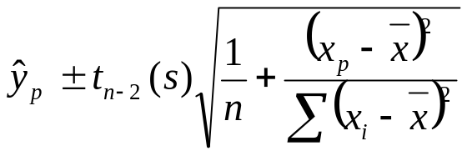
Confidence Interval for Mean Value of y Given x (cont’d)
Confidence Interval for Mean Value of y Given x:
x_{p} given value of x, for which prediction being made
y_{p} point estimate of y, for given value of x
t_{n-2} multiplier associated with sample size and confidence level
s standard error of estimate
Next, prediction interval introduced
Discovering Knowledge in Data: Data Mining Methods and Models, By Daniel T. Larose. Copyright 2005 John Wiley & Sons, Inc.

Slide 45
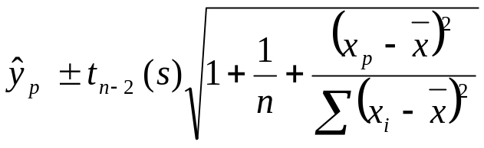
Prediction Interval for Randomly Chosen Value of y Given x (cont’d)
Often, analysts interested in predicting individual value, rather than mean of all values, for given x
Example: predict credit score for single applicant, rather than mean credit score for all applicants, given x
Prediction Interval for Randomly Chosen Value of y, Given x:
Note: similar to confidence interval for mean value of y, given x
Discovering Knowledge in Data: Data Mining Methods and Models, By Daniel T. Larose. Copyright 2005 John Wiley & Sons, Inc.

Slide 46
Consider Orienteering data set size = 10
Measures elapsed time and distance traveled by hikers
Orienteering data set with ERE ŷ = 6 + 2x
Residual (y - ŷ) and residual squared (y - ŷ)² shown
Subject | X = Time | Y = Distance | Predicted Score | Error in Prediction | (Error in Prediction)²
1 | 2 | 10 | 10 | 0 | 0
2 | 2 | 11 | 10 | 1 | 1
3 | 3 | 12 | 12 | 0 | 0
4 | 4 | 13 | 14 | -1 | 1
5 | 4 | 14 | 14 | 0 | 0
6 | 5 | 15 | 16 | -1 | 1
7 | 6 | 20 | 18 | 2 | 4
8 | 7 | 18 | 20 | -2 | 4
9 | 8 | 22 | 22 | 0 | 0
10 | 9 | 25 | 24 | 1 | 1
= 12
Discovering Knowledge in Data: Data Mining Methods and Models, By Daniel T. Larose. Copyright 2005 John Wiley & Sons, Inc.

Slide 47
Prediction Interval for Randomly Chosen Value of y Given x (cont’d)
Formula includes additional constant “1+” under square root
Reflects greater variability associated with estimating single value of y
Prediction interval always wider than confidence interval, give same confidence level
Example: recall ERE for Orienteering data set with 10 hikers
Next, estimated distance traveled for hiker x = 5 hours, results in ŷ = 6 + 2(5) = 16 km
How accurate is point estimate = 16?
Discovering Knowledge in Data: Data Mining Methods and Models, By Daniel T. Larose. Copyright 2005 John Wiley & Sons, Inc.

Slide 48
Prediction Interval for Randomly Chosen Value of y Given x (cont’d)
Our point estimate = 16 does not provide probability statement regarding its accuracy
For each x-value, regression model assumes observed y-values are samples from normal population with mean located on regression line
We have single observation x = 5; however, regression model assumes existence of normal population of hikers with x = 5
Of all hikers in this population, 95% will travel within bounded interval, where distance = 16 km
Discovering Knowledge in Data: Data Mining Methods and Models, By Daniel T. Larose. Copyright 2005 John Wiley & Sons, Inc.

Slide 49
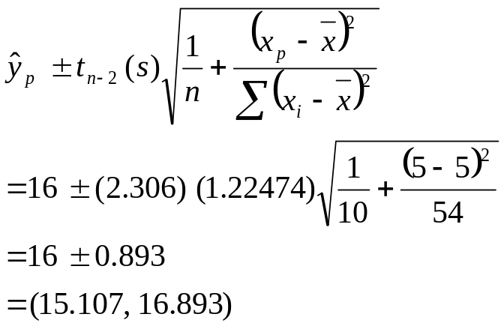
Confidence Interval for Mean Value of y Given x (cont’d)
Therefore, we derive 95% confidence interval for mean distance traveled, for all hikers with x = 5
Confidence Interval:
x_{p} = 5, x-bar = 5, y_{p} = 16, t_{8,95%} = 2.306
s = 1.22474 (from regression results), and n = 10
Discovering Knowledge in Data: Data Mining Methods and Models, By Daniel T. Larose. Copyright 2005 John Wiley & Sons, Inc.

Slide 50
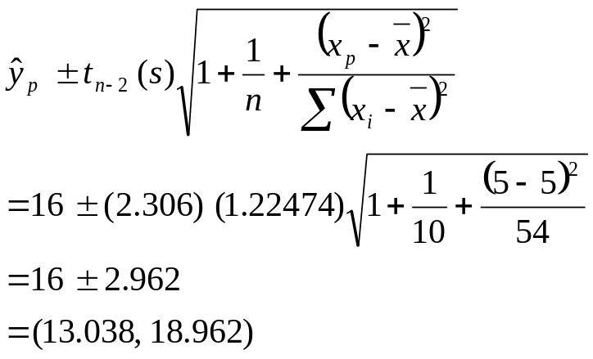
Prediction Interval for Randomly Chosen Value of y Given x (cont’d)
We are 95% confident mean distance traveled by all hikers traveling 5 hours, lies between 15.11 and 16.89 km
Suppose we estimate distance traveled by randomly selected hiker who hiked x = 5 hours?
Prediction Interval:
Discovering Knowledge in Data: Data Mining Methods and Models, By Daniel T. Larose. Copyright 2005 John Wiley & Sons, Inc.

Slide 51
Now, we are 95% confident that distance traveled by randomly select hiker traveling 5 hours, lies between 13.04 and 18.96 km
Recall prediction interval is wider than confidence interval
Again, estimating single response more difficult than estimating mean response
In general, interpretation of prediction interval more useful to analyst
Discovering Knowledge in Data: Data Mining Methods and Models, By Daniel T. Larose. Copyright 2005 John Wiley & Sons, Inc.

Slide 52
Verifying Regression Assumptions
Four inferential methods described require adherence to regression assumptions
Two graphical methods used to verify assumptions:
  (1) Normal probability plot of residuals
  (2) Plot of standardized residuals against
  predicted values
Method 1: Normal Probability Plot
Quantile-Quantile plot of quantiles of particular distribution against quantiles of standard normal distribution
Discovering Knowledge in Data: Data Mining Methods and Models, By Daniel T. Larose. Copyright 2005 John Wiley & Sons, Inc.

Slide 53
Quantile of distribution x_{p}, measures p% of distribution less than or equal to x_{p}
Determines whether specified distribution deviates from normality
Observed values from distribution compared against same number observations expected from normal distribution
Where normal, bulk of points should lie on straight line
Otherwise, systematic deviations from linearity denote non-normality
Discovering Knowledge in Data: Data Mining Methods and Models, By Daniel T. Larose. Copyright 2005 John Wiley & Sons, Inc.

Slide 54
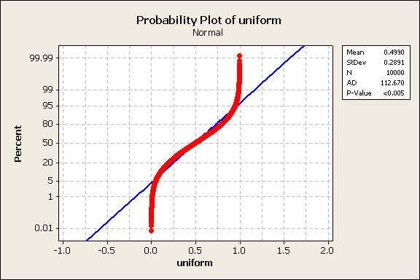
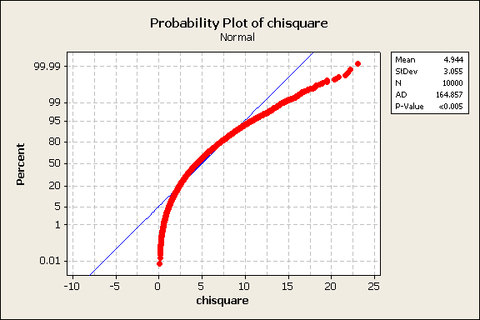
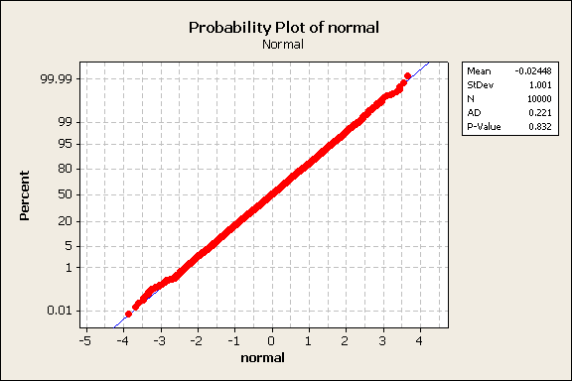
Verifying Regression Assumptions (cont’d)
A
Three examples show
normal probability plots for:
-(A) Uniform(0,1)
-(B) Chi-square(5)
-(C) Normal(0,1)
B
C
Discovering Knowledge in Data: Data Mining Methods and Models, By Daniel T. Larose. Copyright 2005 John Wiley & Sons, Inc.

Slide 55
Verifying Regression Assumptions (cont’d)
(A) Uniform(0,1)
Clear pattern (reverse S curve) exists indicating systematic deviation from normality
Uniform distribution is rectangular-shaped distribution with heavy tails
(B) Chi-Square(5)
Again, clear pattern indicates systematic deviation from normality
Chi-Square(5) distribution is right-skewed
Plot appearance typical of right-skewed distributions
Discovering Knowledge in Data: Data Mining Methods and Models, By Daniel T. Larose. Copyright 2005 John Wiley & Sons, Inc.

Slide 56
(C) Normal(0,1)
All points line up on straight line indicating normality
Expected behavior for data drawn from Normal distribution
However, sampling error and noise found in real-world data make decisions about normality less certain
Note, each probability plot generated by Minitab shows AD statistic and corresponding p-value
Discovering Knowledge in Data: Data Mining Methods and Models, By Daniel T. Larose. Copyright 2005 John Wiley & Sons, Inc.

Slide 57
AD refers to Anderson-Darling test for normality
Small values of AD indicate normal distribution better fit to data set
Null hypothesis Ho asserts normal distribution fits data
Therefore, small p-value implies lack of fit
For example, p-value < 0.005 for Uniform and Chi-Square examples, indicating strong evidence for lack of fit
However, p-value = 0.832 for Normal example, indicating lack of evidence to reject Ho
Discovering Knowledge in Data: Data Mining Methods and Models, By Daniel T. Larose. Copyright 2005 John Wiley & Sons, Inc.

Slide 58
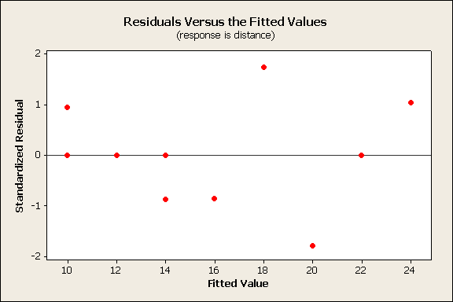
Method 2: Plot Standardized Residuals Against Fits (Predicted Values)
Example shows regression of distance vs. time for Orienteering data set
Regression line (ERE) shown
as horizontal blue line
Discernable patterns in
residuals vs. fits indicates
regression assumptions
violated
Here, too few data points exist to make determination
Discovering Knowledge in Data: Data Mining Methods and Models, By Daniel T. Larose. Copyright 2005 John Wiley & Sons, Inc.

Slide 59
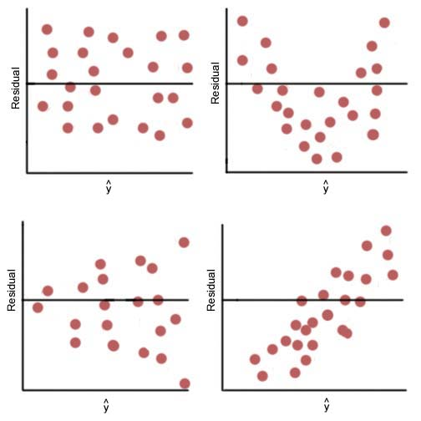
Four commonly found patterns in
residual-fit plots shown
Plot (A): “healthy” plot where no
discernible patterns exist
Data points form overall
rectangular shape
Here, regression assumptions
remain intact
Plot (B): exhibits curvature,
which violates independence
assumption
A
B
C
D
Discovering Knowledge in Data: Data Mining Methods and Models, By Daniel T. Larose. Copyright 2005 John Wiley & Sons, Inc.
Notes:
A較集中是最好的模型 期末考可能會出誰最好

Slide 60
Question: Why does Plot B violate independence assumption?
  Residuals, which estimate errors, assumed to exhibit independence
  Residuals form curved pattern
  Therefore, for given residual, we may predict where neighboring residuals fall
  However, if residuals independent, no prediction possible
Plot (C): displays “funnel” pattern, which violates constant variance assumption
Question: Why does Plot C violate constant variance assumption?
Discovering Knowledge in Data: Data Mining Methods and Models, By Daniel T. Larose. Copyright 2005 John Wiley & Sons, Inc.

Slide 61
  Residual variance lower for smaller values of x, where variance increases as x-values increase
  Therefore, constant variance assumption violated
Plot (D): shows pattern increasing from left to right, which violates zero-mean assumption
Question: Why does Plot D violate zero-mean assumption?
  Zero-mean states mean of error term zero, regardless of x-value
  Plot shows small x-values have mean less than 0
  Large x-values have mean greater than 0
  Therefore, zero-mean assumption violated
Discovering Knowledge in Data: Data Mining Methods and Models, By Daniel T. Larose. Copyright 2005 John Wiley & Sons, Inc.

Slide 62
Verifying Regression Assumptions (cont’d)
Diagnostic Tests
Several diagnostic hypothesis tests exist to validate regression assumptions
Anderson-Darling test validates residual fit to normal distribution
Bartlett’s test or Levene’s test indicates whether constant variance assumption violated
Durban-Watson test or runs test assesses whether independence assumption violated
Discovering Knowledge in Data: Data Mining Methods and Models, By Daniel T. Larose. Copyright 2005 John Wiley & Sons, Inc.

Slide 63
Conclusion
Suppose normality plot shows no systematic deviation from linearity, and
Residuals-fits plot shows no discernible patterns
Therefore, graphical evidence shows no evidence regression assumptions violated
Question: What if graphical tests indicate regression assumption(s) violated?
For example, constant variance assumption violated
Here, transforming response using ln(y) may help
Discovering Knowledge in Data: Data Mining Methods and Models, By Daniel T. Larose. Copyright 2005 John Wiley & Sons, Inc.

